Slide 1


BlockMail – A Blockchain-based Email System
Student Number: 170146926
Student Name: Thomas Daniel Herring
Supervisor Name: Professor Steve Uhlig

Slide 2
Project Aims
Explore blockchain in a communication application.
Evaluate the benefits of blockchain, and assess potential for future applications.
Create an easily expandable, reliable, and secure distributed system that can communicate over a fixed protocol.
Deliver an application of blockchain to the mainstream. Should be as simple to sign up and use as a conventional email system.
Applications so far tend to bombard the user with information about security. Somewhat intimidating.
Finally – prove that blockchain has a place in secure communications!

Slide 3
Project Objectives
Use Cryptography to secure the network and its data.
RSA Public-Key Cryptography for email contents.
ECDSA for addresses.
A “public” and “open” blockchain, that allows any party to join and contribute to the processing of emails being sent over the network.
A responsive front-end interface that is operable on any device with a browser and JavaScript support.
Proof-of-Stake algorithm implemented. Based primarily on block length.
Master nodes provide initial “start” of the network.
8 to begin with – expandable. Reduce for testing.

Slide 4
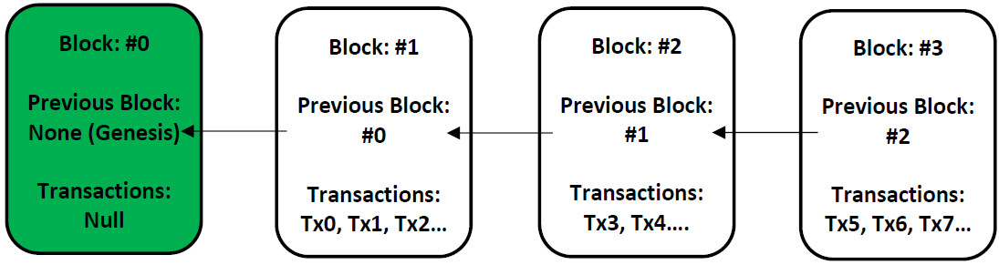
Why is this a Computing problem?
Computing focuses on driving new and existing technology:
Blockchain has only existed for a decade, and is still being explored, so...
There are gaps for development and specific applications of Blockchain.
The nature of the project explores numerous aspects of Computer Science, including:
Cryptography.
Hashing (email addresses).
Public-Key (email contents).
Peer-to-Peer Networking.
Distributed Systems.
Consensus Protocols.

Slide 5
Literature Review Findings
Existing Solutions:
CryptaMail – 2014 [1].
Based on NxtCoin protocol.
LedgerMail – 2019 [2].
A “private” blockchain.
Conceptualising Blockchains: Characteristics & Applications – Sultan, K; Ruhi, U; Lakhani, R [3]:
Definition of Blockchain - “A decentralized database containing sequential, cryptographically linked blocks of digitally signed asset transactions, governed by a consensus model.”
“Semi-public” blockchain.
(Invited Paper) on The Security of Blockchain Consensus Protocols – Das, S; Kolluri, A; Saxena, P, Yu, H [4]:
“Honest” and “Dishonest” Peers.
“Stability” – Every block links to its previous cryptographically.
“Agreement” – Every node must agree on the set of confirmed blocks.
“Fairness” – Concept of 51% attack.

Slide 6
Proposed Solution
Master Node 1
Master Node 2
Master Node 3
Master Node 4
Master Node 5
Master Node 6
Master Node 7
Master Node 8
Other Nodes
Master Nodes – Hard Coded. Provide initial contact point for other nodes joining the network.
As network expands no longer required.

Slide 7
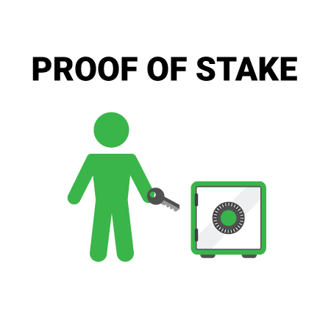
Proposed Solution Continued…
The interface will connect to master nodes when sending / viewing mail.
Will either process or direct to other nodes for processing.
Every node will generate a block with all transactions over a time period.
Will initially be low, but will increase with network capacity.
Proof-of-Stake – The node with the largest block length will be elected to add that block onto the chain.

Slide 8
Evaluation of Solution
Impact Evaluation:
Have the mandatory objectives been achieved?
To what extent have the optional objectives been achieved?
Measure immediate success of the solution (short-term).
Useful in “pilot programs which are due to be substantially scaled up”[5] – in line with BlockMail.
+ Quick to evaluate.
- May be inaccurate without real data.
Outcome Evaluation:
Have the project aims been fulfilled?
Did anything change during development? Why?
Are any of these changes unintentional?
Measure the likelihood of long-term success of the project (long-term).
Good for measuring projects that are expected to run for an extended period of time, as well as those which have clearly defined aims.
+ Looks at project in a wider context.
- Fulfillment of aims is somewhat subjective.
Combination of these methods will ensure a comprehensive evaluation can be carried out.
Benefits and downfalls complement each other.
Alternatives, such as process evaluation, were not selected as the project does not target one particular audience.
Instead a range of audiences.

Slide 9
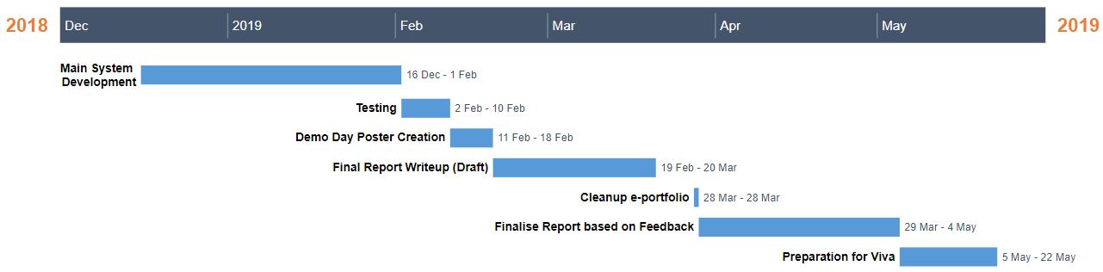
Project Planning
So Far:
Completed shell for front-end UI.
Node communication and discovery.
Going forward:

Slide 10
Risk Register
Risk | Likelihood Rating | Impact Rating | Impact Description | Preventative Actions
Overestimation of time for the project. | Medium. | High. | May not deliver a complete project. | Set out strict time limits using tools such as GANTT charts. Continuously have progress reviews with supervisor.
Computer failure. | Low. | High. | Could lead to loss of work and non-submission. | Ensure that frequent backups are taken. Have a secondary PC that can be used in case of emergency.
Underestimation of the project cost. | Medium. | Medium. | May not be able to buy certain pieces of hardware or software that are required for the project. | Construct a clear outline of hardware and software requirements prior to beginning implementation.
Implementation of unnecessary features. | Medium. | Medium. | May clutter code and waste time that could be spent in other areas. | Ensure that features meet requirements without being over-engineered.
Poor requirements outline. | Medium. | Medium. | A poor definition of requirements at the start of the project may lead to time being wasted during the development phase, as requirements are gathered. | Produce a detailed set of requirements, which provide a modular style feature-set.
Lack of experience in the language(s) used for the solution. | Medium. | Medium. | May produce a sub-par solution with poor programming style. | Prepare for using languages by completing tutorials and researching modules to be used.
Unforeseen illness. | Low. | Medium. | An illness could lead to some time lost during development. | Maintain good personal hygiene.
Plagiarism. | Medium. | High. | May result in mark being zeroed. | Be informed about how to reference, and how to ensure that others are given proper credit for their work. If not sure – ask.

Slide 11
References
[1] CryptaMail. (2019). CryptaMail. [online] Available at: http://www.cryptamail.com/ [Accessed 10 Nov. 2019].
[2] Ledgermail.io. (2019). World's first email service on Blockchain | Best Blockchain based Encrypted Email Service. [online] Available at: https://ledgermail.io/ [Accessed 10 Nov. 2019].
[3] Sultan, K; Ruhi, U; Lakhani, R (2018). [online] Conceptualizing Blockchains: Characteristics and Applications. Available at: https://arxiv.org/ftp/arxiv/papers/1806/1806.03693.pdf [Accessed 14 Nov. 2019].
[4] Das, S; Kolluri, A; Saxena, P; Yu, H (2018). [online] (Invited Paper) on the Security of Blockchain Consensus Protocols. Available at: https://www.researchgate.net/publication/329437697_Invited_Paper_on_the_Security_of_Blockchain_Consensus_Protocols_14th_International_Conference_ICISS_2018_Bangalore_India_December_17-19_2018_Proceedings [Accessed 16 Nov. 2019]
[5] Oecd.org. (2019). [online] Available at: https://www.oecd.org/dac/evaluation/dcdndep/37671602.pdf [Accessed 2 Dec. 2019].

